Slide 1
Audieyes: Enhancing Visual Accessibility through Advanced AI Technologies.
Ayoub Maimmadi

Slide 2
Agenda
Introduction
Project Overview
Technical Framework
Implementation Details
Deployment and Operations
Responsible AI Practices
Future Directions & Conclusion

Slide 3

Introduction

Slide 4

Project Overview
Problem Statement
Business Case and Metrics

Slide 5
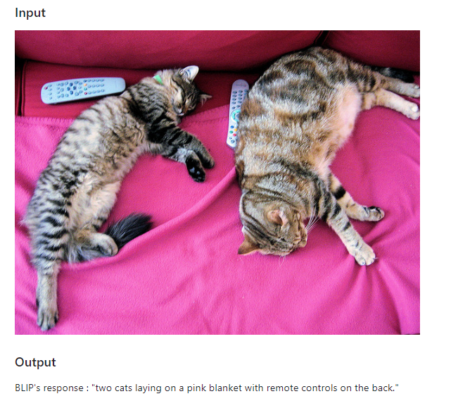
Leveraging machine learning, Audieyes enhances its core functionalities, offering personalized experiences and improving the accuracy and efficiency of its features. ML drives the project's innovative edge, from image recognition to predictive analytics for navigation.

Slide 6
Business Case
Business Metrics
1. Market Expansion:
2. Brand Differentiation.
3. Operational Efficiency:
4. Customer Loyalty and Retention:
5. Data-Driven Insights for Product Development: .
The Audieyes project presents a compelling business case by addressing a critical and underserved market: the accessibility needs of the visually impaired community. Through innovation and user-centric design, Audieyes not only fulfills a social imperative but also taps into a market with significant growth potential.

Slide 7
Implementation Details
ML Pipeline Development
From Monolith to MLOps Pipeline
MLflow for Experiment Tracking
Meta Store Setup

Slide 8
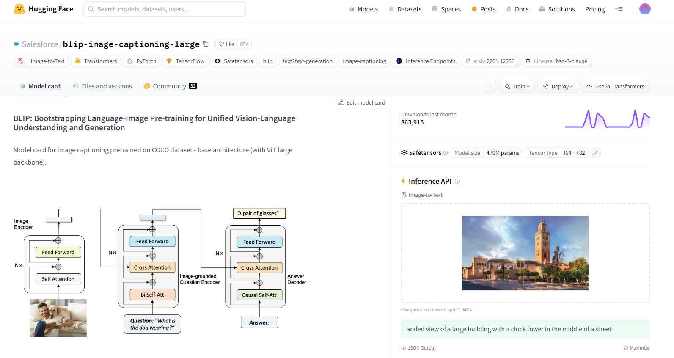

Slide 9
From a Monolith to a Pipeline
Project structure definition and modularity
Code Versioning
Data versioning
Experiment tracking and model versioning
Setting up a meta store for metadata
Setting up the machine learning pipeline

Slide 10

Project structure definition and modularity

Slide 11


Code
Versioning

Slide 12
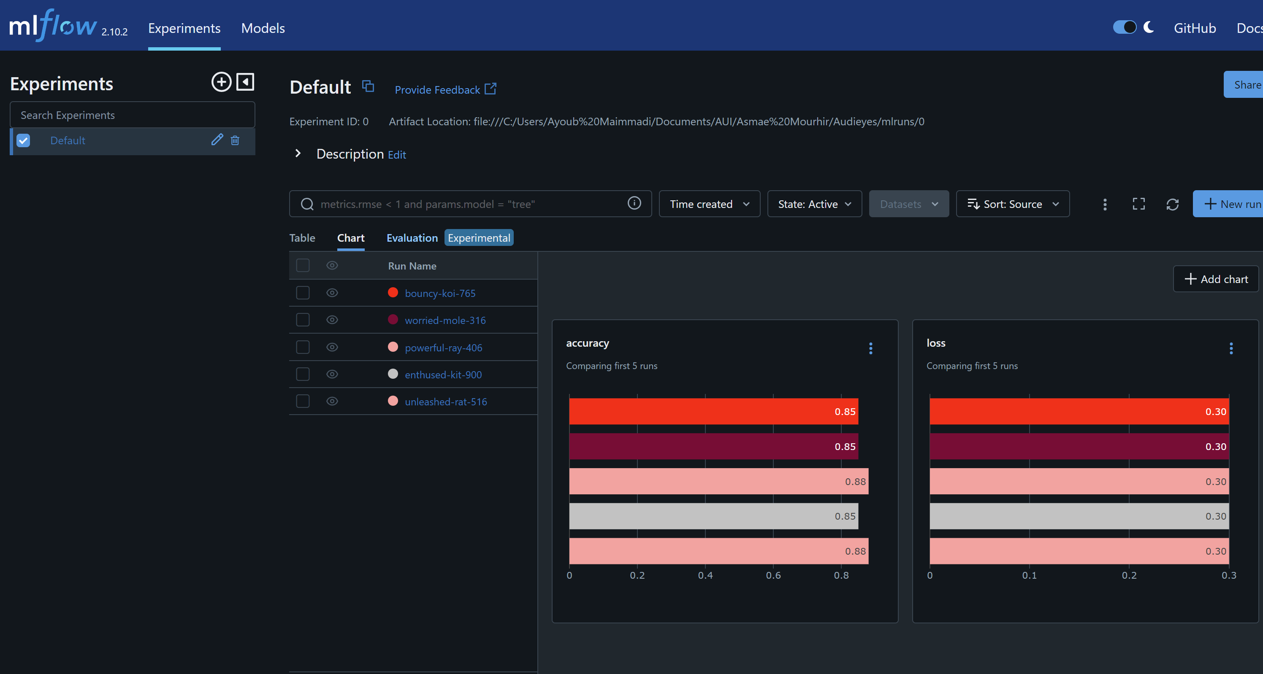
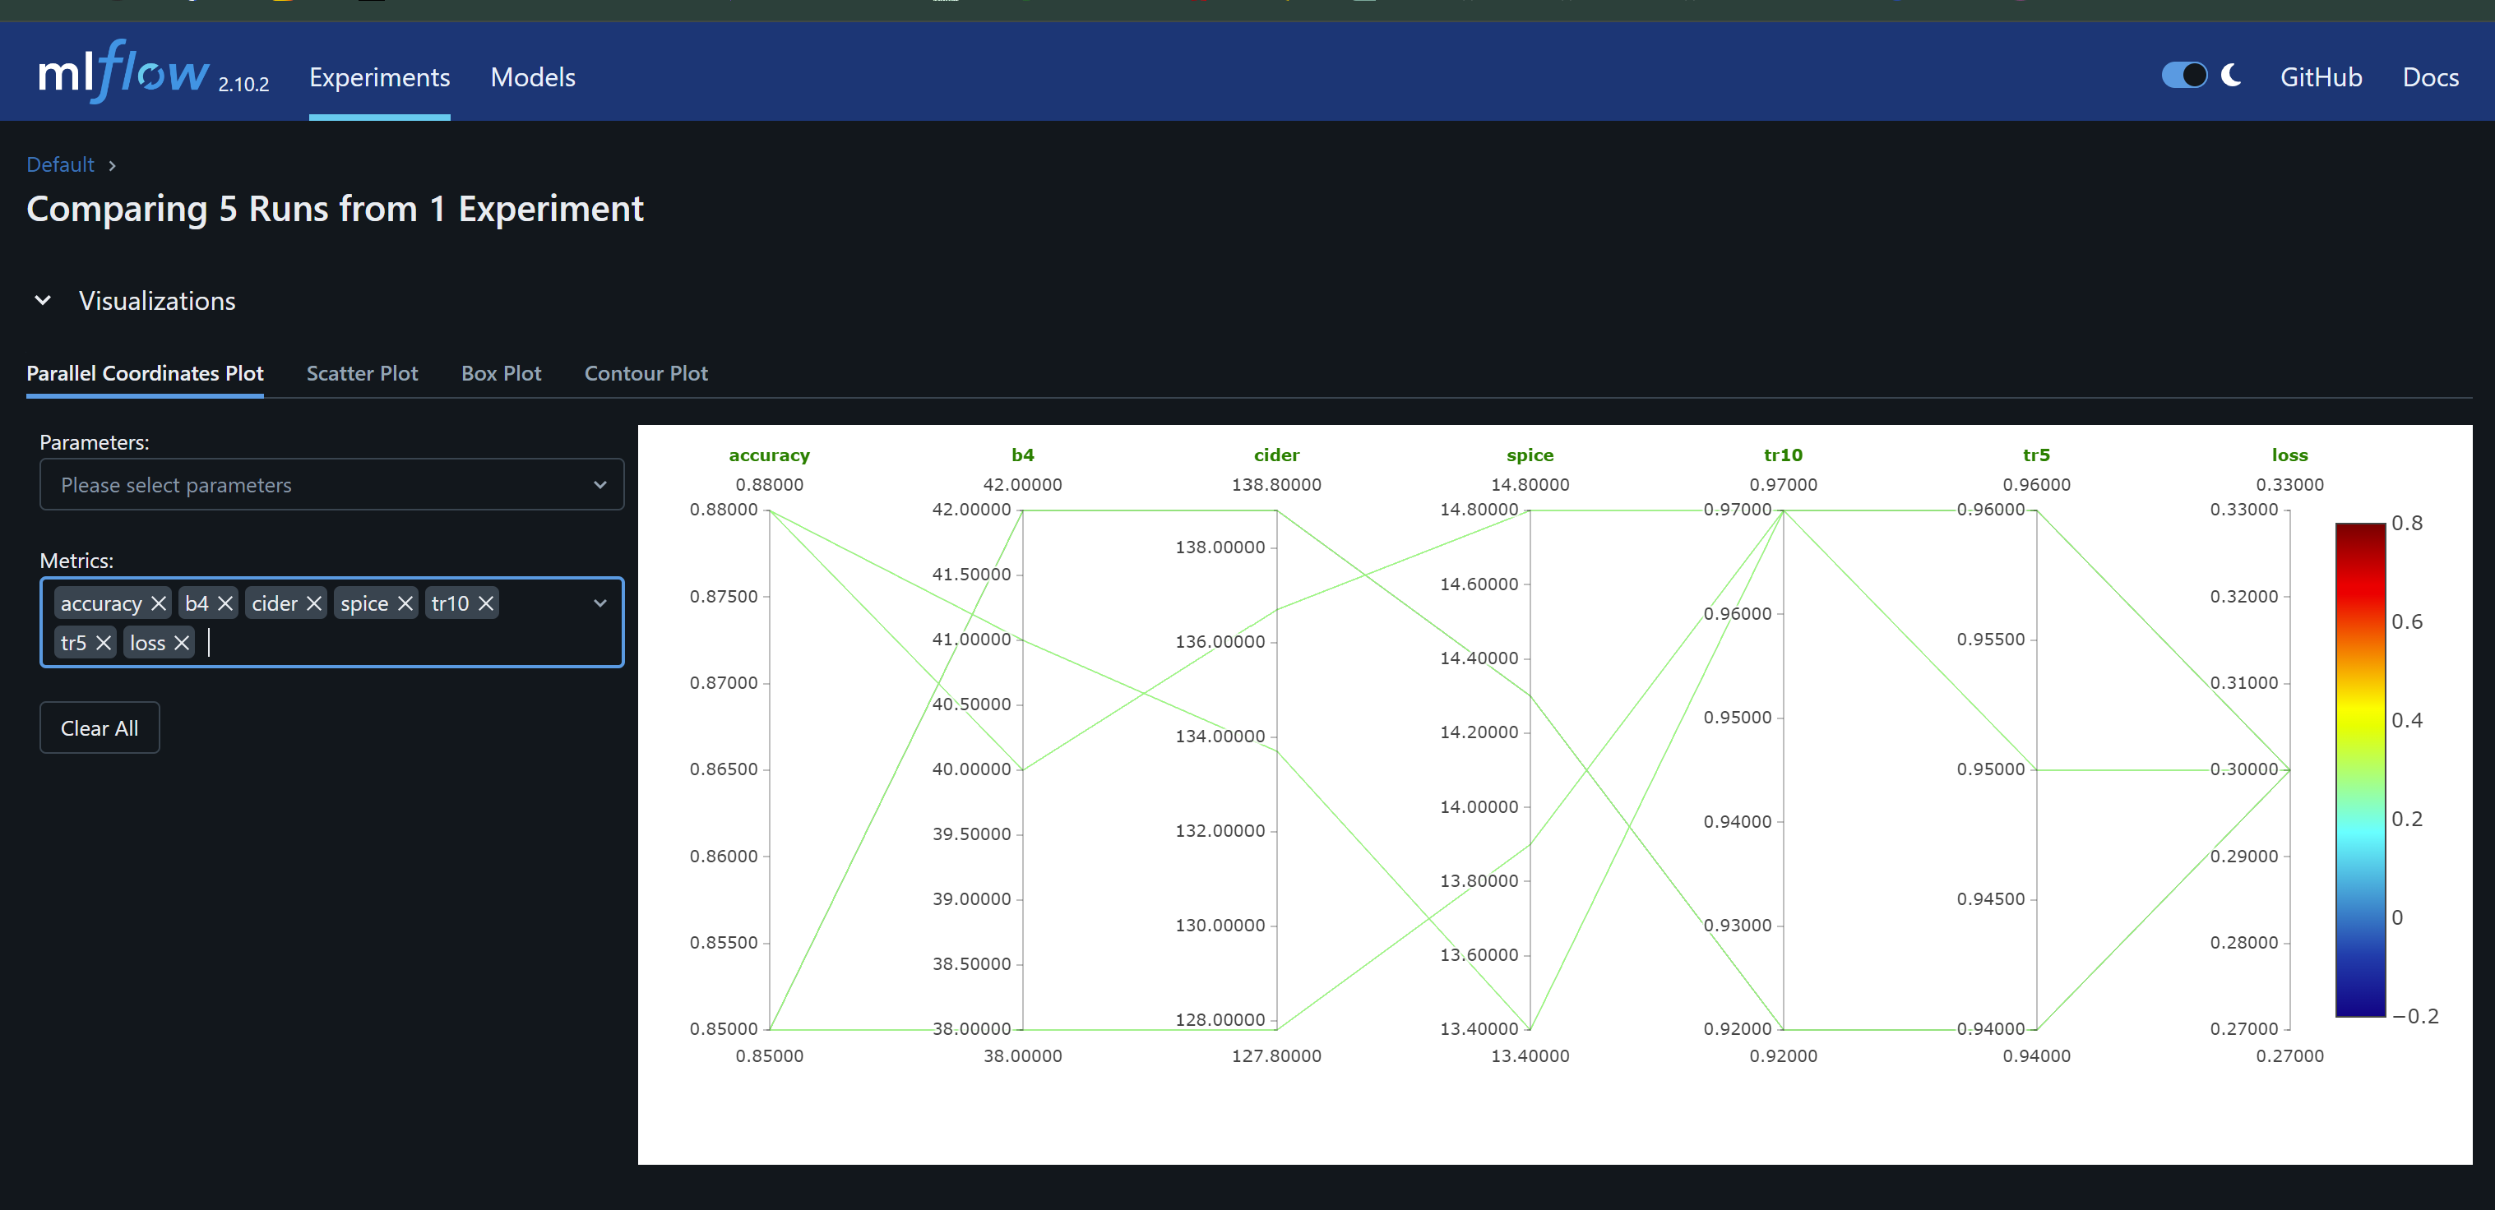
Experiment tracking and model versioning

Slide 13
Setting up a meta store for metadata

Slide 17
Deployment and Operations
Service
Model Service Development
Client
Front-end Client using React
Strategies
Model Deployment Strategies
Docker, Linode, and Kubernetes

Slide 18
Responsible AI Practices
1. Evaluation Beyond Accuracy
2. Audit Model for Bias

Slide 19
Dynamic delivery
Learn to infuse energy into your delivery to leave a lasting impression
One of the goals of effective communication is to motivate your audience
Metric | Measurement | Target | Actual
Audience attendance | # of attendees | 150 | 120
Engagement duration | Minutes | 60 | 75
Q&A interaction | # of questions | 10 | 15
Positive feedback | Percentage (%) | 90 | 95
Rate of information retention | Percentage (%) | 80 | 85

Slide 20
Final tips & takeaways
Consistent rehearsal
Strengthen your familiarity
Refine delivery style
Pacing, tone, and emphasis
Timing and transitions
Aim for seamless, professional delivery
Practice audience
Enlist colleagues to listen & provide feedback
Seek feedback
Reflect on performance
Explore new techniques
Set personal goals
Iterate and adapt

Slide 21
Navigating Q&A sessions
Impact factor | Measurement | Target | Achieved
Audience interaction | Percentage (%) | 85 | 88
Knowledge retention | Percentage (%) | 75 | 80
Post-presentation surveys | Average rating | 4.2 | 4.5
Referral rate | Percentage (%) | 10 | 12
Collaboration opportunities | # of opportunities | 8 | 10

Slide 22
Thank you

